Slide 1
Character generation
Tan Zi Xu S10185168C

Slide 2
01
02
05
03
04
Overview
Data Loading & Processing
Problem, Objective, Approach
Data Cleansing and Encoding
Summary
Model Development
Summarize Model Performance & Suggestion for Improvement
Build, Train, Tune, Analyse Model Performance
Model Evaluation
Provide Manual Input & Analyze Generated Text

Slide 3
Overview
Problem, Objective, Approach

Slide 4
OverView
Problem: How can we emulate human literature with Machine?
Objective:
Build a language model capable of generating semi-coherent english sentences at a character level
Approach:
Identified as a Classification Task
Use Existing Literature as data (e.g., The Adventures of Sherlock Holmes)
Develop & train a RNN model with a GRU layer
Test model with Manual Inputs

Slide 5
Data LOADING & Preprocessing
Data Cleansing and Encoding

Slide 6
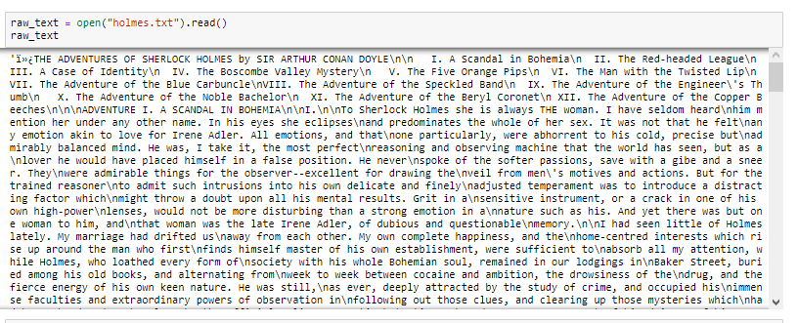
Data Loading

Slide 7

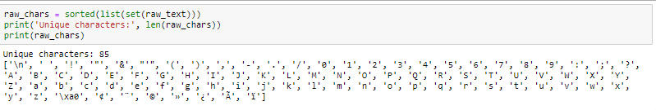
Data Exploration
Findings:
Number of characters in raw text = 562439
Number of unique characters in raw text = 85

Slide 8
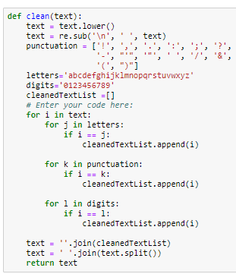
Data Cleansing
Cleansing steps:
Replace upper casing with lower casing
Replace escape sequence with whitespace
Establish letters, digits & punctuations to retain
Create list of cleansed text
Turn cleansed text back to a string while removing additional whitespace

Slide 9
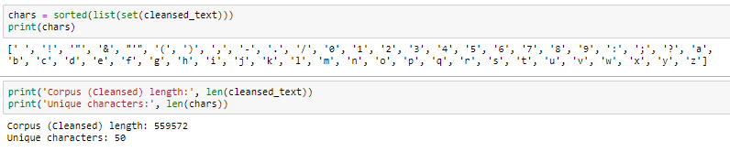
Data Cleansing
Result of cleansed text
Number of characters in cleansed text = 559572
Number of unique characters in cleansed text = 50

Slide 10
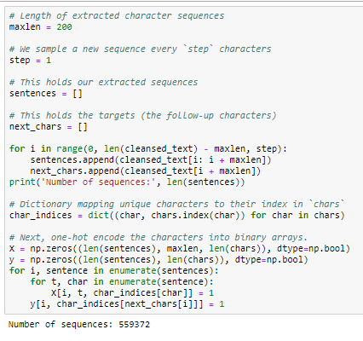
Data Encoding
Data prepared with Sliding Window Technique to:
Have a total of 559372 Sequences
Each sequence with Max Length of 200
Vectorized & One Hot Encoded the sequences with dictionary mapping of unique characters in cleansed text

Slide 11
Model development
Build, Train, Tune, Analyse Model Performance

Slide 12
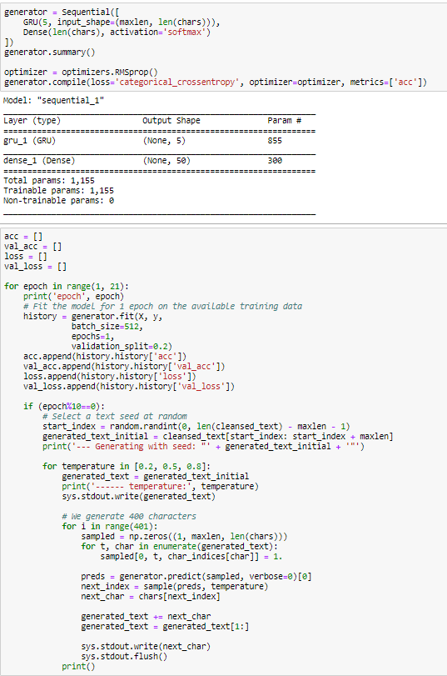
Base GRU model
Started simple base model with:
GRU layer with 5 neuron
Dense layer of 50 neurons with softmax activation
Compiling Configuration:
Optimizer is RMSProp
Loss is categorical_crossentropy for multiclass, single label classification
Accuracy as metrics
Fitting:
20 training epochs
Big batch size of 512
20% training data used for validation
Printed generated text after 10th & final epoch using softmax temperature OF 0.2, 0.5 & 0.8

Slide 13
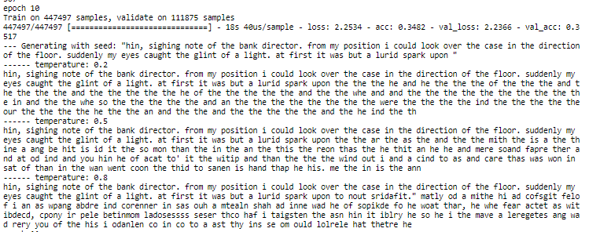
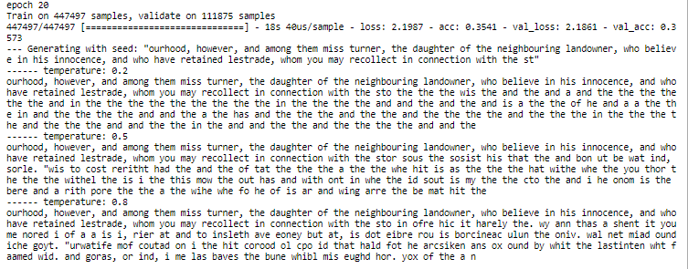
Base GRU model- TEXT gENERATED

Slide 14
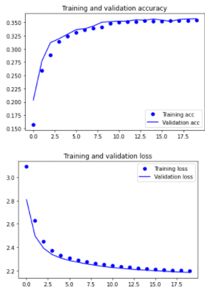
Base GRU model- CHARTS
Results:
Clear underfitting
Text generated are very repetitive
Accuracy=~35.41%, Validation Accuracy=~35.73%
Actions:
Should try scaling up the model
5 neurons in 1 GRU might be too narrow for the dataset
Widen model network instead of deepen

Slide 15
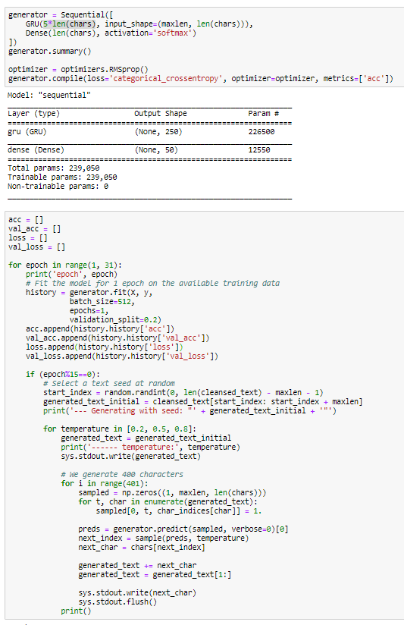
Scaled up GRU model
Changes:
Increase the number of neurons in GRU layer to be same as number of unique characters
5-fold the neurons to purposely scale and overfit the model
Training epochs to 30
Text generated are now done at 15th & final epoch

Slide 16
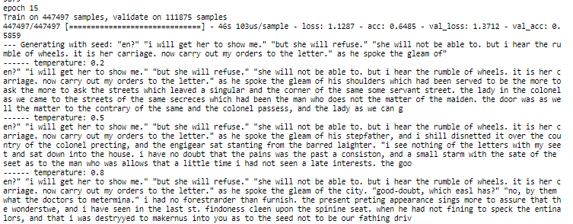
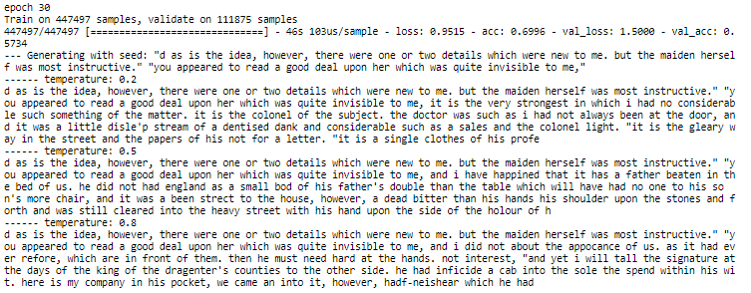
Scaled up GRU model - TEXT gENERATED

Slide 17
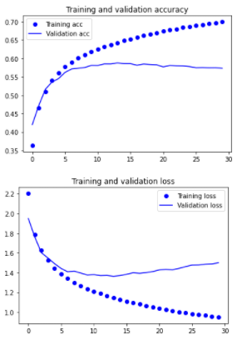
Scaled up GRU model - CHARTS
Results:
Clear overfitting
Text generated no longer repetitive, became more coherent
Accuracy=~69.96%
Peaked Validation Accuracy=~58.79% @ epoch 14
Actions:
Should deploy regularization technique
Avoid dropout, use regularizers instead

Slide 18
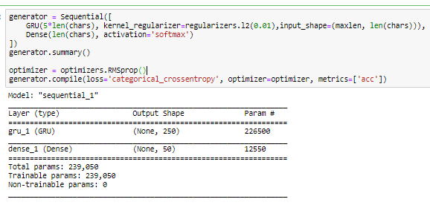
Regularized GRU model
Changes:
Add L2 regularizer to kernel_regularizer
Regularizer set to 0.01

Slide 19
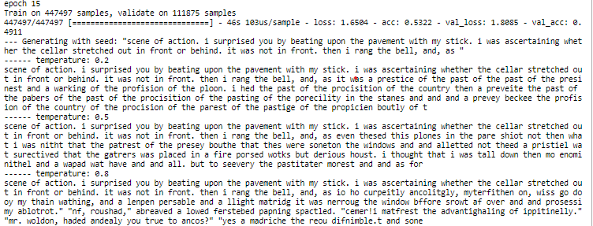
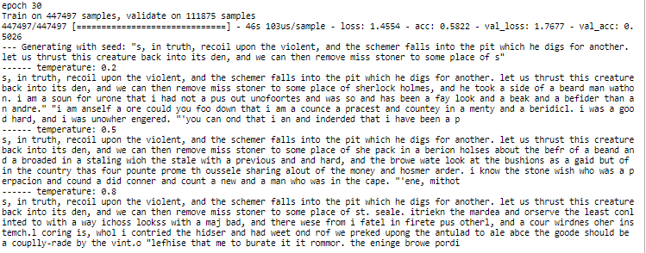
Regularized GRU model - TEXT gENERATED

Slide 20
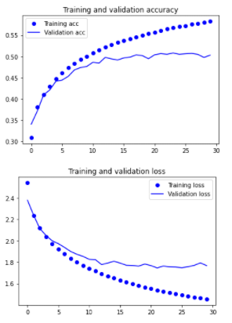
Regularized GRU model - CHARTS
Results:
Still overfitting, accuracy dropped significantly
Text generated became less coherent, words not properly formed
Accuracy=~58.22%
Peaked Validation Accuracy=~50.77% @ epoch 24
Actions:
Take a step back, maybe try another optimizer
Try Adam optimizer

Slide 21
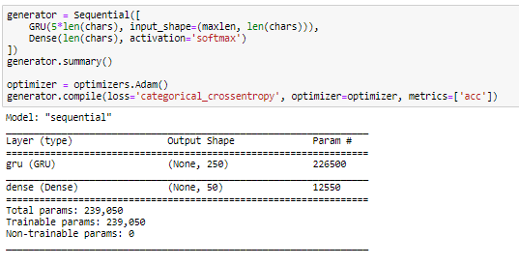
Adam optimized GRU model
Changes:
Replaced RMSProp with Adam optimizer

Slide 22
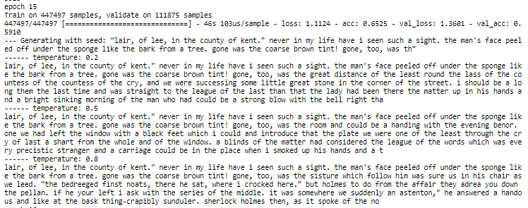
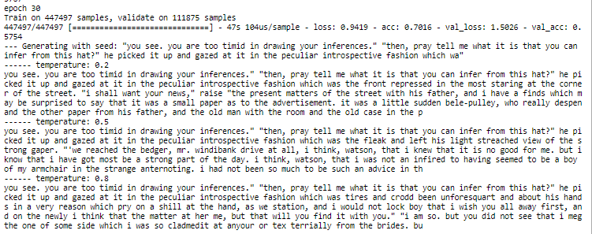
Adam optimized GRU model- TEXT gENERATED

Slide 23
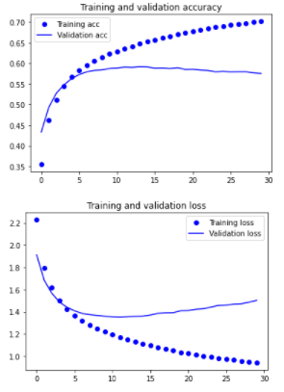
Adam optimized GRU model- CHARTS
Results:
Still overfitting, but slightly better than RMSProp models
Text generated relatively coherent
Accuracy=~70.16%
Peaked Validation Accuracy=~59.15% @ epoch 14
Actions:
Early stopping as last resort, at 8th epoch to avoid overfitting
Try generating text between 0.2 to 0.5 for better quality text

Slide 24
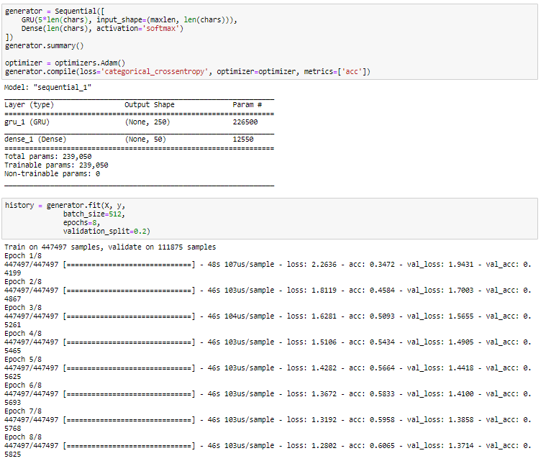
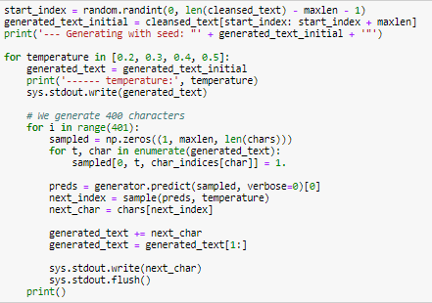
Final GRU model
Changes:
Early Stopped model at 8th epoch
Generate text from 0.2 to 0.5 temperature

Slide 25
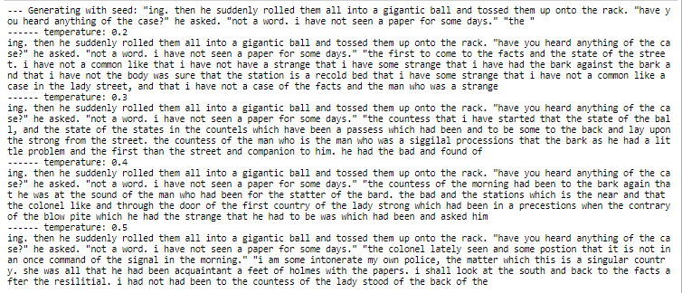
final GRU model- TEXT gENERATED

Slide 26
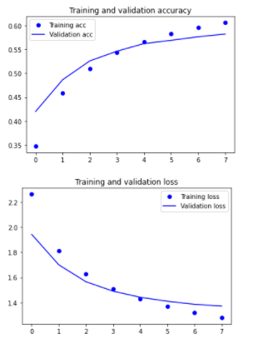
Final GRU model- CHARTS
Results:
Text generated relatively coherent
Accuracy=60.65%
Validation Accuracy=~58.25%
Actions:
Save model as 'CharGenerator.h5’
Proceed to Model Evaluation

Slide 27
Model evaluation
Provide Manual Input & Analyze Generated Text

Slide 28
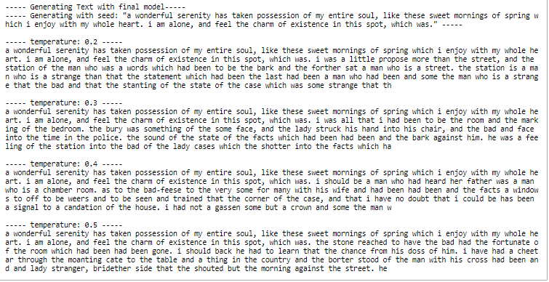
TEXT generated from manual INPUT
The model was able to produce semi-coherent sentences
Minimal typos
No repetition
Makes a little sense
Seems to have some fluidity in linguistic fluency

Slide 29
Summary
Summarize Model Performance & Suggestion for Improvement

Slide 30
Summary of MODEL
No repetitive words
Model did not exhibit any repetition in generating the text, even at lower temperature. Where models are expected to repeat certain words
Minimal typos
The model will occassionally make typo mistakes, creating words that does not exist
Capable of generating semi-coherent text
Model could complete sentence, writing out a story. However, it is not fully coherent, the context would be abruptly losing its meaning

Slide 31
Improvements
Obtain more data
Used another text cleansing method
Try another type of Layer
Increasing literature of another writer could invoke enhance quality of model training
There could be some noise in the data, stringent cleaning with Regular Expression might be useful
LSTM, Conv1D, SimpleRNN or even Bi-litateral layers could possibly yield better results

Slide 32
Thanks

